Slide 1
Lead Score Case Study
Submitted by : Prateek Raj Srivastava Shreya Mandlesha

Slide 2
Lead Score Case Study for X Education
Problem Statement :
X Education sells online courses to industry professionals. The company markets its courses on several websites and search engines like Google.
Once these people land on the website, they might browse the courses or fill up a form for the course or watch some videos. When these people fill up a form providing their email address or phone number, they are classified to be a lead. Moreover, the company also gets leads through past referrals.
Once these leads are acquired, employees from the sales team start making calls, writing emails, etc. Through this process, some of the
leads get converted while most do not. The typical lead conversion rate at X education is around 30%.
Business Goal:
X Education needs help in selecting the most promising leads, i.e. the leads that are most likely to convert into paying customers.
The company needs a model wherein you a lead score is assigned to each of the leads such that the customers with higher lead score have
a higher conversion chance and the customers with lower lead score have a lower conversion chance.
The CEO, in particular, has given a ballpark of the target lead conversion rate to be around 80%.

Slide 3

Strategy
Source the data for analysis Clean and prepare the data Exploratory Data Analysis. Feature Scaling
Splitting the data into Test and Train dataset.
Building a logistic Regression model and calculate Lead Score.
Evaluating the model by using different metrics - Specificity and Sensitivity or Precision and Recall. Applying the best model in Test data based on the Sensitivity and Specificity Metrics.

Slide 4
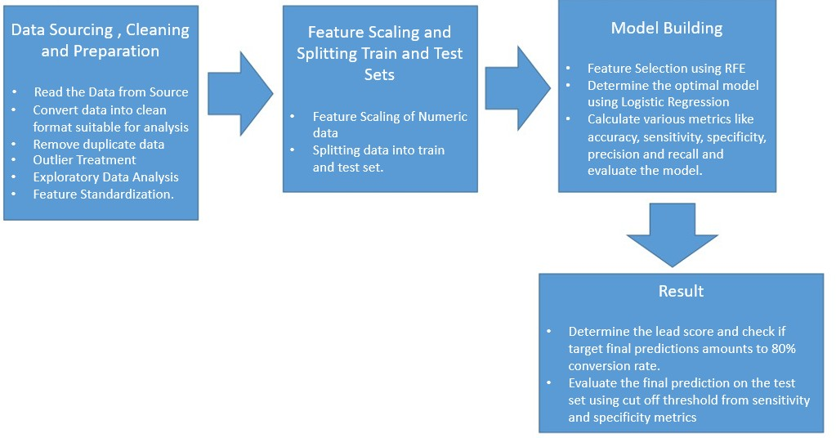
Problem solving methodology

Slide 5
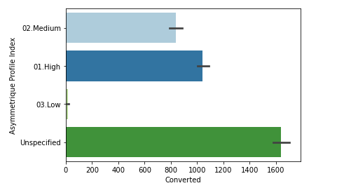
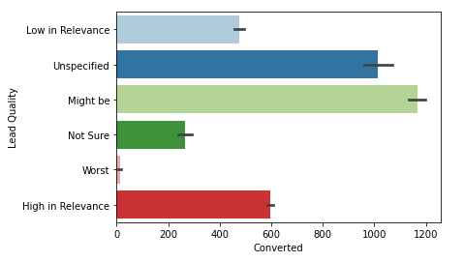
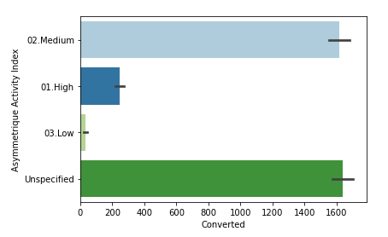
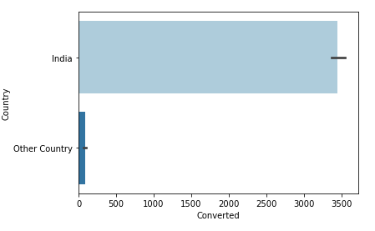
Exploratory Data Analysis We filled the null or missing values in a “unspecified” category

Slide 6
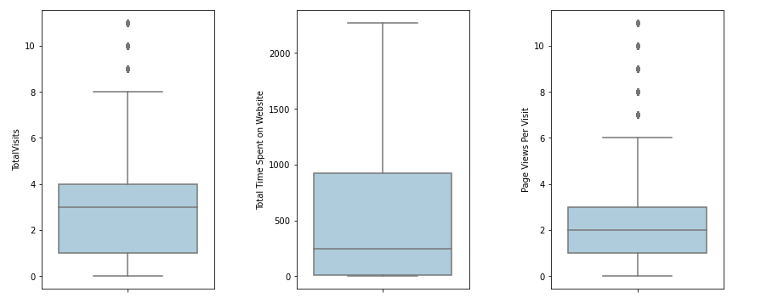
Outlier Treatment

Slide 7
Variables Impacting the Conversion Rate
'Lead Source_Welingak Website',
'Lead Quality_Worst',
'Tags_Already a student',
'Tags_Closed by Horizzon',
'Tags_Interested in full time MBA',
'Tags_Interested in other courses',
'Tags_Lost to EINS',
'Tags_Not doing further education',
'Tags_Ringing',
'Tags_Will revert after reading the email',
'Tags_switched off',
'Last Activity_SMS Sent'

Slide 8
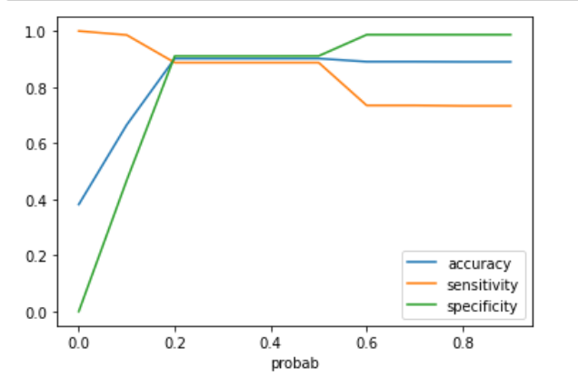

Model Evaluation - Sensitivity and Specificity on Train Data Set we have took the cutoff 0.52

Slide 9
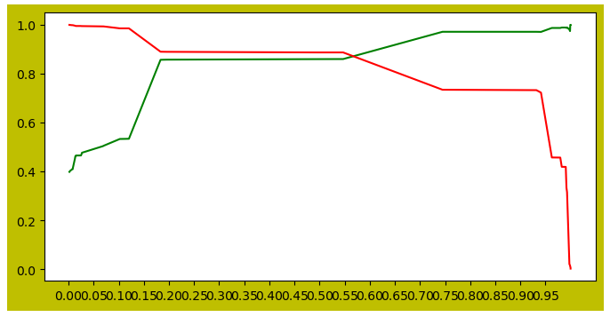
Model Evaluation- Precision and Recall on Train Dataset According to this the cutoff is near 0.57

Slide 10
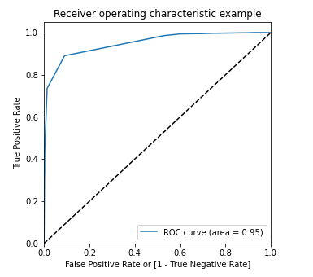
ROC Curve for train-data set

Slide 11
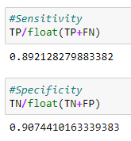

Model Evaluation - Sensitivity and Specificity on Test Dataset

Slide 12
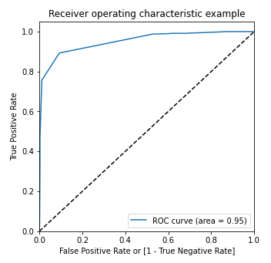
ROC Curve for test-data set

Slide 13
Conclusion
While we have checked both Sensitivity-Specificity as well as Precision and Recall Metrics, we have considered the optimal cut off based on
Sensitivity and Specificity for calculating the final prediction. -
Accuracy, Sensitivity and Specificity values of test set are around 90%, 89% and 90% which are approximately closer to the respective values
calculated using trained set.
Also the lead score calculated shows the conversion rate on the final predicted model is around 87% (in train set) and 87% in test set
The top 3 variables that contribute for lead getting converted in the model are
Tags_Lost to EINS
Tags_Closed by Horizzon
Tags_Will revert after reading the email
Hence overall this model seems to be good.

